Slide 1

Cloud Computing: At a glance
Risala T. Khan
Professor
IIT, JU

Slide 2
Introduction
Computing is being transformed into a model consisting of services that are commoditized and delivered in a manner similar to utilities such as water, electricity, gas, and telephony.
In such a model, users access services based on their requirements, regardless of where the services are hosted.
Several computing paradigms, such as grid computing, have promised to deliver this utility computing vision.
Cloud computing is the most recent emerging paradigm promising to turn the vision of “computing utilities” into a reality

Slide 3
Introduction (Cont..)
Cloud computing is a technological advancement that focuses on the way we design computing systems, develop applications, and leverage existing services for building software.
It is based on the concept of dynamic provisioning, which is applied not only to services but also to compute capability, storage, networking, and information technology (IT) infrastructure in general.
Resources are made available through the Internet and offered on a pay-per-use basis from cloud computing vendors.
Today, anyone with a credit card can subscribe to cloud services and deploy and configure servers for an application in hours, growing and shrinking the infrastructure serving its application according to the demand, and paying only for the time these resources have been used

Slide 4
Cloud computing at a glance
This vision of computing utilities based on a service-provisioning model made the massive transformation of the entire computing industry in the 21st century, whereby computing services will be readily available on demand, just as other utility services such as water, electricity, telephone, and gas are available in today’s society.
Similarly, users (consumers) need to pay providers only when they access the computing services.
In addition, consumers no longer need to invest heavily or encounter difficulties in building and maintaining complex IT infrastructure.

Slide 5
Continue…
In such a model, users access services based on their requirements without regard to where the services are hosted.
This model has been referred to as utility computing or, recently (since 2007), as cloud computing.
The latter term often denotes the infrastructure as a “cloud” from which businesses and users can access applications as services from anywhere in the world and on demand.
Hence, cloud computing can be classified as a new paradigm for the dynamic provisioning of computing services supported by state-of-the-art data centers employing virtualization technologies for consolidation and effective utilization of resources.
Cloud computing allows renting infrastructure, runtime environments, and services on a pay-per-use basis.

Slide 6
The vision of cloud computing
Cloud computing allows anyone with a credit card to rent virtual hardware, runtime environments, and services.
These are used for as long as needed, with no up-front commitments required.
The entire stack of a computing system is transformed into a collection of utilities, which can be rented and composed together to deploy systems in hours rather than days and with virtually no maintenance costs.
This opportunity, initially met with skepticism, has now become a practice across several application domains and business sectors (see Figure 1.1).
The demand has fast tracked technical development and enriched the set of services offered, which have also become more sophisticated and cheaper

Slide 7
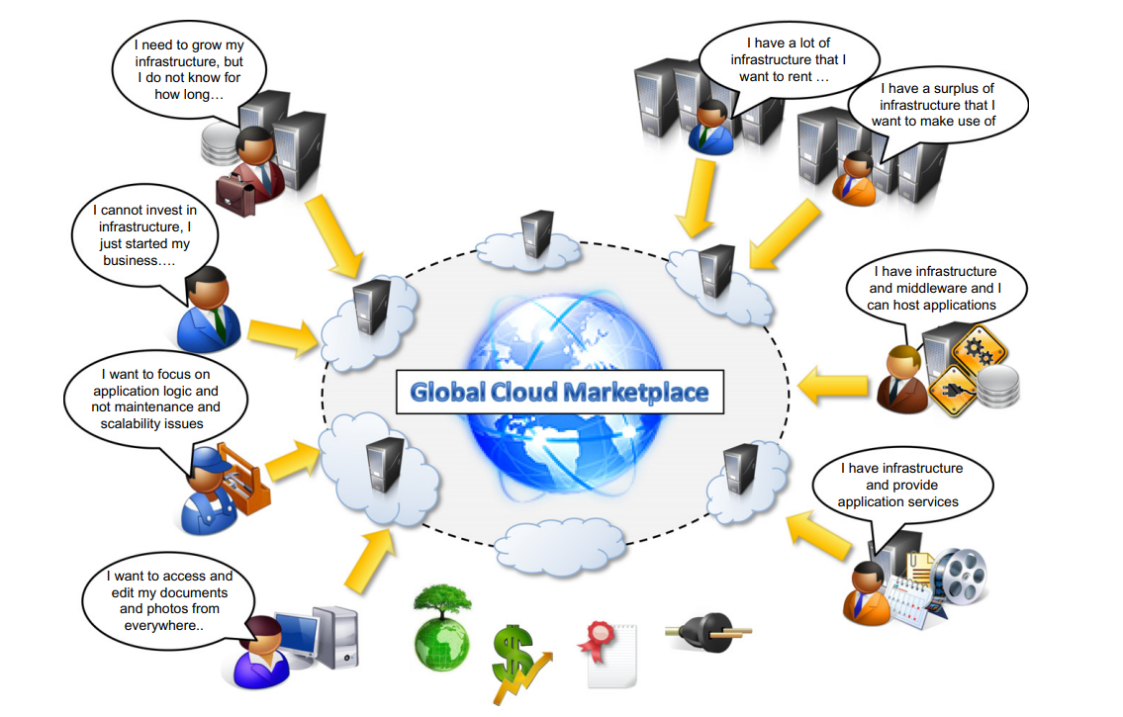

Slide 8
Reason for using Cloud
Different stakeholders use clouds for a variety of services.
The need for ubiquitous storage and compute power on demand is the most common reason to consider cloud computing.
A scalable runtime for applications is an attractive option for application and system developers that do not have infrastructure or cannot afford any further expansion of existing infrastructure.
The capability for Web based access to documents and their processing using sophisticated applications is one of the appealing factors for end users

Slide 9
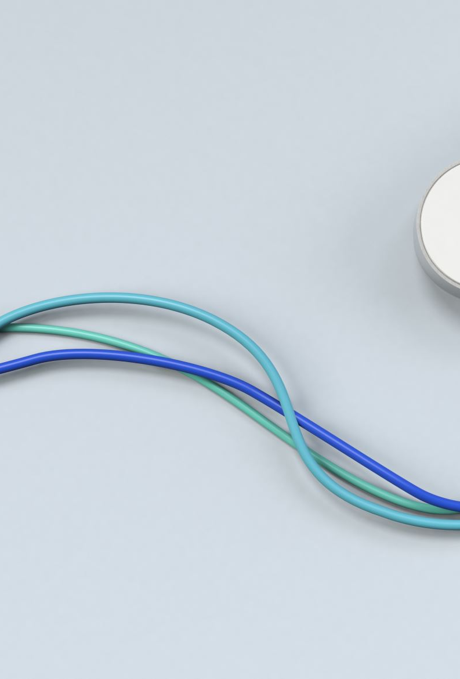
What to expect from Cloud?? What next??
In all the cases, the discovery of cloud services is mostly done by human intervention: a person (or a team of people) looks over the Internet to identify offerings that meet his or her needs.
We imagine that in the near future it will be possible to find the solution that matches our needs by simply entering our request in a global digital market that trades cloud computing services.
The existence of a global platform for trading cloud services will also help service providers become more visible and therefore potentially increase their revenue.
A global cloud market also reduces the barriers between service consumers and providers: it is no longer necessary to belong to only one of these two categories. For example, a cloud provider might become a consumer of a competitor service in order to fulfill its own promises to customers.

Slide 10

What is Cloud??
Cloud computing has become a popular buzzword; it has been widely used to refer to different technologies, services, and concepts.
It is often associated with virtualized infrastructure or hardware on demand, utility computing, IT outsourcing, platform and software as a service, and many other things that now are the focus of the IT industry.
Figure 1.2 depicts the plethora of different notions included in current definitions of cloud computing.

Slide 11
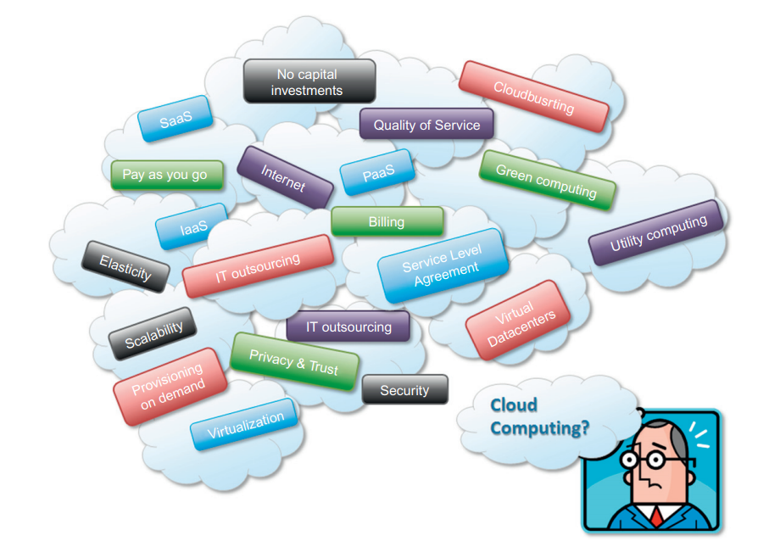

Slide 12
The term cloud has historically been used in the telecommunications industry as an abstraction of the network in system diagrams.
It then became the symbol of the most popular computer network: the Internet. This meaning also applies to cloud computing, which refers to an Internet-centric way of computing.
The Internet plays a fundamental role in cloud computing, since it represents either the medium or the platform through which many cloud computing services are delivered and made accessible.

Slide 13
Formal Definition of Cloud Computing
“Cloud computing refers to both the applications delivered as services over the Internet and the hardware and system software in the data centers that provide those services.”
This definition describes cloud computing as a phenomenon touching on the entire stack: from the underlying hardware to the high-level software services and applications.
It introduces the concept of everything as a service, mostly referred as XaaS, where the different components of a system—IT infrastructure, development platforms, databases, and so on—can be delivered, measured, and consequently priced as a service.
This new approach significantly influences not only the way that we build software but also the way we deploy it, make it accessible, and design our IT infrastructure, and even the way companies allocate the costs for IT needs.
The approach fostered by cloud computing is global: it covers both the needs of a single user hosting documents in the cloud or one of the large companies deciding to deploy part of or the entire corporate IT infrastructure in the public cloud.

Slide 14
Continue..
Another important aspect of cloud computing is its utility-oriented approach.
Cloud computing focuses on delivering services with a given pricing model, in most cases a “pay-per-use” strategy.
It makes it possible to access online storage, rent virtual hardware, or use development platforms and pay only for their effective usage, with no or minimal up-front costs.
All these operations can be performed and billed simply by entering the credit card details and accessing the exposed services through a Web browser.
This helps us provide a different and more practical characterization of cloud computing.

Slide 15
According to Reese , we can define three criteria to discriminate whether a service is delivered in the cloud computing style:
• The service is accessible via a Web browser (nonproprietary) or a Web services application programming interface (API).
• Zero capital expenditure is necessary to get started.
• You pay only for what you use as you use it.
Even though many cloud computing services are freely available for single users, enterpriseclass services are delivered according a specific pricing scheme.

Slide 16
A closer look on Cloud Computing
Cloud computing is helping enterprises, governments, public and private institutions, and research organizations shape more effective and demand-driven computing systems.
Practical examples of such systems exist across all market segments:
• Large enterprises can offload some of their activities to cloud-based systems.
Recently, the New York Times has converted its digital library of past editions into a Web-friendly format. This required a considerable amount of computing power for a short period of time. By renting Amazon EC2 and S3 Cloud resources, the Times performed this task in 36 hours and relinquished these resources, with no additional costs.
• Small enterprises and start-ups can afford to translate their ideas into business results more quickly, without excessive up-front costs.
Animoto is a company that creates videos out of images, music, and video fragments submitted by users. The process involves a considerable amount of storage and backend processing required for producing the video, which is finally made available to the user. Animoto does not own a single server and bases its computing infrastructure entirely on Amazon Web Services, which are sized on demand according to the overall workload to be processed.

Slide 17
Cont…
System developers can concentrate on the business logic rather than dealing with the complexity of infrastructure management and scalability.
Little Fluffy Toys is a company in London that has developed a widget providing users with information about nearby bicycle rental services. The company has managed to back the widget’s computing needs on Google AppEngine and be on the market in only one week.
End users can have their documents accessible from everywhere and any device.
Apple iCloud is a service that allows users to have their documents stored in the Cloud and access them from any device users connect to it. This makes it possible to take a picture while traveling with a smartphone, go back home and edit the same picture on your laptop, and have it show as updated on your tablet computer. This process is completely transparent to the user, who does not have to set up cables and connect these devices with each other.

Slide 18
Cloud Reference Models
The three major models for deploying and accessing cloud computing environments are public clouds, private/enterprise clouds, and hybrid clouds (see Figure 1.4).
Public clouds are the most common deployment models in which necessary IT infrastructure (e.g., virtualized data centers) is established by a third-party service provider that makes it available to any consumer on a subscription basis.
Such clouds are appealing to users because they allow users to quickly leverage compute, storage, and application services.
In this environment, users’ data and applications are deployed on cloud data centers on the vendor’s premises.

Slide 19
Continue..
Large organizations that own massive computing infrastructures can still benefit from cloud computing by replicating the cloud IT service delivery model in-house.
This idea has given birth to the concept of private clouds as opposed to public clouds.
In 2010, for example, the U.S. federal government, one of the world’s largest consumers of IT spending (around $76 billion on more than 10,000 systems) started a cloud computing initiative aimed at providing government agencies with a more efficient use of their computing facilities.
The use of cloud-based in-house solutions is also driven by the need to keep confidential information within an organization’s premises.
Institutions such as governments and banks that have high security, privacy, and regulatory concerns prefer to build and use their own private or enterprise clouds.

Slide 20
Continue…
Whenever private cloud resources are unable to meet users’ quality-of-service requirements, hybrid computing systems, partially composed of public cloud resources and privately owned infrastructures, are created to serve the organization’s needs.
These are often referred as hybrid clouds, which are becoming a common way for many stakeholders to start exploring the possibilities offered by cloud computing

Slide 21
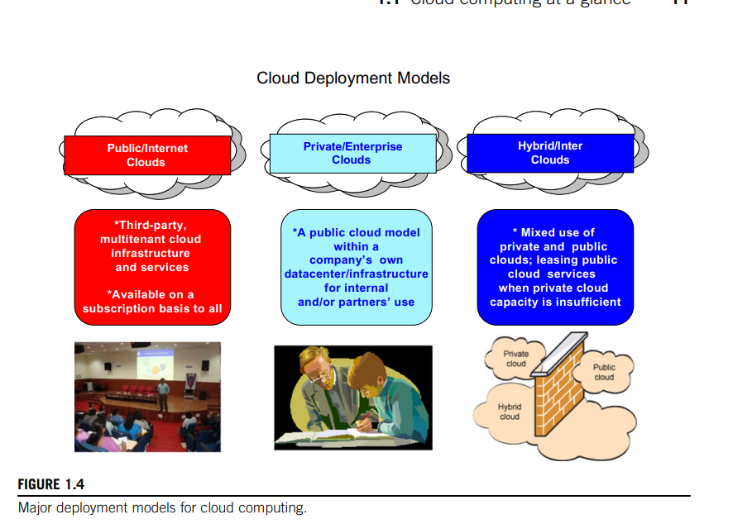

Slide 22
Characteristics & Benefits of Cloud
Cloud computing has some interesting characteristics that bring benefits to both cloud service consumers (CSCs) and cloud service providers (CSPs).
These characteristics are:
• No up-front commitments
• On-demand access
• Nice pricing
• Simplified application acceleration and scalability
• Efficient resource allocation
• Energy efficiency
• Seamless creation and use of third-party services

Slide 23
Cont…
The most evident benefit from the use of cloud computing systems and technologies is the increased economical return due to the reduced maintenance costs and operational costs related to IT software and infrastructure.
This is mainly because IT assets, namely software and infrastructure, are turned into utility costs, which are paid for as long as they are used, not paid for up front.
Capital costs are costs associated with assets that need to be paid in advance to start a business activity.
Before cloud computing, IT infrastructure and software generated capital costs, since they were paid in advance so that business start-ups could afford a computing infrastructure, enabling the business activities of the organization.
The revenue of the business is then utilized to compensate over time for these costs.
Organizations always minimize capital costs, since they are often associated with depreciable values.

Slide 24
Cont..
This is the case of hardware: a server bought today for $1,000 will have a market value less than its original price when it is eventually replaced by new hardware.
To make profit, organizations have to compensate for this depreciation created by time, thus reducing the net gain obtained from revenue.
Minimizing capital costs, then, is fundamental.
Cloud computing transforms IT infrastructure and software into utilities, thus significantly contributing to increasing a company’s net gain.
Moreover, cloud computing also provides an opportunity for small organizations and start-ups: these do not need large investments to start their business, but they can comfortably grow with it.
Finally, maintenance costs are significantly reduced: by renting the infrastructure and the application services, organizations are no longer responsible for their maintenance. This task is the responsibility of the cloud service provider, who can bear the maintenance costs
Notes:
Why minimising capital cost is fundamental?

Slide 25
Cont..
End users can benefit from cloud computing by having their data and the capability of operating on it always available, from anywhere, at any time, and through multiple devices.
Information and services stored in the cloud are exposed to users by Web-based interfaces that make them accessible from portable devices as well as desktops at home.
Since the processing capabilities (that is, office automation features, photo editing, information management, and so on) also reside in the cloud, end users can perform the same tasks that previously were carried out through considerable software investments.
The cost for such opportunities is generally very low, since the cloud service provider shares its costs across all the tenants that he is servicing.
Multitenancy allows for better utilization of the shared infrastructure that is kept operational and fully active.

Slide 26
Challenges of Cloud Computing
As any new technology develops and becomes popular, new issues have to be faced.
Cloud computing is not an exception.
New, interesting problems and challenges are regularly being posed to the cloud community, including IT practitioners, managers, governments, and regulators.
Besides the practical aspects, which are related to configuration, networking, and sizing of cloud computing systems, a new set of challenges concerning the dynamic provisioning of cloud computing services and resources arises.
For example, in the Infrastructure-as-a-Service domain, how many resources need to be provisioned, and for how long should they be used, in order to maximize the benefit?
Technical challenges also arise for cloud service providers for the management of large computing infrastructures and the use of virtualization technologies on top of them.
In addition, issues and challenges concerning the integration of real and virtual infrastructure need to be taken into account from different perspectives, such as security.

Slide 27
Cont..
Security in terms of confidentiality, secrecy, and protection of data in a cloud environment is another important challenge.
Organizations do not own the infrastructure they use to process data and store information.
This condition poses challenges for confidential data, which organizations cannot afford to reveal.
Therefore, assurance on the confidentiality of data and compliance to security standards, which give a minimum guarantee on the treatment of information on cloud computing systems, are sought.
The problem is not as evident as it seems: even though cryptography can help secure the transit of data from the private premises to the cloud infrastructure, in order to be processed the information needs to be decrypted in memory.
This is the weak point of the chain: since virtualization allows capturing almost transparently the memory pages of an instance, these data could easily be obtained by a malicious provider.

Slide 28
Cont…
Legal issues may also arise.
These are specifically tied to the ubiquitous nature of cloud computing, which spreads computing infrastructure across diverse geographical locations.
Different constrain about privacy in different countries may potentially create disputes as to the rights that third parties (including government agencies) have to your data.
U.S. legislation is known to give extreme powers to government agencies to acquire confidential data when there is the suspicion of operations leading to a threat to national security.
European countries are more restrictive and protect the right of privacy.
An interesting scenario comes up when a U.S. organization uses cloud services that store their data in Europe. In this case, should this organization be suspected by the government, it would become difficult or even impossible for the U.S. government to take control of the data stored in a cloud datacenter located in Europe.

Slide 29
Virtualization
Virtualization is another core technology for cloud computing.
It encompasses a collection of solutions allowing the abstraction of some of the fundamental elements for computing, such as hardware, runtime environments, storage, and networking.
Virtualization is essentially a technology that allows creation of different computing environments.
These environments are called virtual because they simulate the interface that is expected by a guest.
The most common example of virtualization is hardware virtualization.
Hardware virtualization allows the coexistence of different software stacks on top of the same hardware.
These stacks are contained inside virtual machine instances, which operate in complete isolation from each other.
This is the base technology that enables cloud computing solutions to deliver virtual servers on demand, such as Amazon EC2, RightScale, VMware vCloud, and others.

Slide 30
What are the component of H/W Virtualization
The hardware layer, or virtualization host, contains the physical server components such as CPU, memory, network, and disk drives. This is the physical hardware on which virtualization takes place. It requires an x86-based system with one or more CPUs to run all supported guest operating systems.
The hypervisor creates a virtualization layer that runs between the OS and the server hardware, allowing many instances of an operating system or different operating systems to run in parallel on a single machine. Hypervisors isolate operating systems and applications from the underlying computer hardware, or the host machine, from the virtual machines that use its resources.
Virtual machines are software emulations of a computing hardware environment and provide the functionalities of a physical computer. Virtual machines themselves consist of virtual hardware, a guest operating system, and guest software or applications.

Slide 31
How does H/W Virtualization Work
Hardware virtualization enables a single physical machine to function as multiple machines by creating simulated environments.
The physical host uses software called a hypervisor that creates an abstraction layer between the software and hardware and manages the shared physical hardware resources between the guest and host operating systems.
The hypervisor connects directly to the hardware and enables it to be split into multiple distinct environments or virtual machines.
These VMs use the resources of the physical host, including CPU, memory, and storage, which are allocated to the guests as needed.

Slide 32
Web 2.0
The Web is the primary interface through which cloud computing delivers its services.
At present, the Web encompasses a set of technologies and services that facilitate interactive information sharing, collaboration, user-centered design, and application composition.
This evolution has transformed the Web into a rich platform for application development and is known as Web 2.0.
This term captures a new way in which developers architect applications and deliver services through the Internet and provides new experience for users of these applications and services
Web 2.0 applications are extremely dynamic: they improve continuously, and new updates and features are integrated at a constant rate by following the usage trend of the community.
There is no need to deploy new software releases on the installed base at the client side. Users can take advantage of the new software features simply by interacting with cloud application.
Examples of Web 2.0 applications are Google Documents, Google Maps, Flickr, Facebook, Twitter, YouTube, de.li.cious, Blogger, and Wikipedia.

Slide 33
Service-oriented Computing
Service orientation is the core reference model for cloud computing systems.
This approach adopts the concept of services as the main building blocks of application and system development.
Service-oriented computing (SOC) supports the development of rapid, low-cost, flexible, interoperable, and evolvable application.
A service is an abstraction representing a self-describing component that can perform any function—anything from a simple function to a complex business process.
Virtually any piece of code that performs a task can be turned into a service and expose its functionalities through a network-accessible protocol.
A service is supposed to be loosely coupled, reusable, programming language independent, and location transparent.
Loose coupling allows services to serve different scenarios more easily and makes them reusable.
Independence from a specific platform increases services accessibility.
Thus, a wider range of clients, which can look up services in global registries and consume them in a location-transparent manner, can be served.

Slide 34
Utility-oriented Computing
Utility computing is a vision of computing that defines a service-provisioning model for compute services in which resources such as storage, compute power, applications, and infrastructure are packaged and offered on a pay-per-use basis.
The idea of providing computing services as a utility like natural gas, water, power, and telephone connection has a long history but has become a reality today with the advent of cloud computing.
The first traces of this service-provisioning model can be found in the mainframe era. IBM and other mainframe providers offered mainframe power to organizations such as banks and government agencies.
The idea of computing as utility remained and extended from the business domain to academia with the advent of cluster computing.
From an application and system development perspective, service-oriented computing and service-oriented architectures (SOAs) introduced the idea of leveraging external services for performing a specific task within a software system.
Applications were not only distributed, they started to be composed as a mesh of services provided by different entities. [for example payment gateway service integrated in e-commerce site]
These services, accessible through the Internet, were made available by charging according to usage

